Slide 1

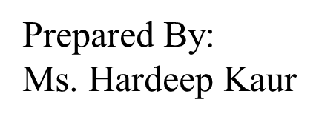
UNIVERSITY INSTITUTE OF ENGINEERING
COMPUTER SCIENCE ENGINEERING
Bachelor of Engineering (Computer Science & Engineering)
Subject Name: STATISTICAL METHODS USING R
Subject Code: 20SMT-460

Slide 2
Variance

Slide 3
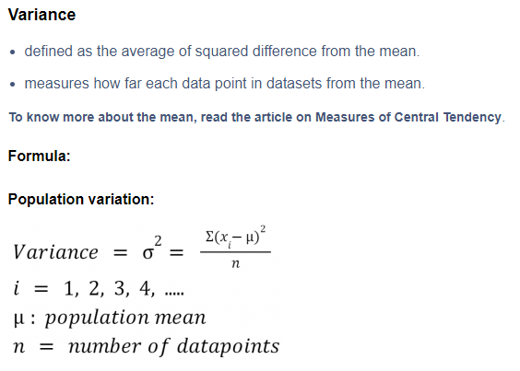

Slide 4
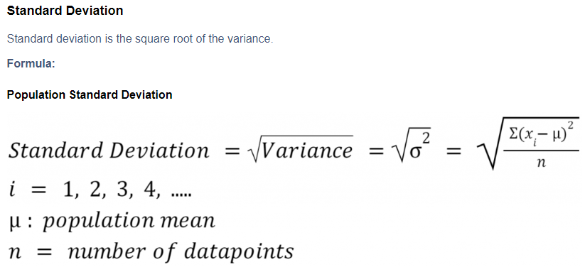

Slide 5
Problem Statement:
Let there be 5 students of height 1m, 2m, 3m, 4m and 5m.
Calculate the Standard Deviation.

Slide 6
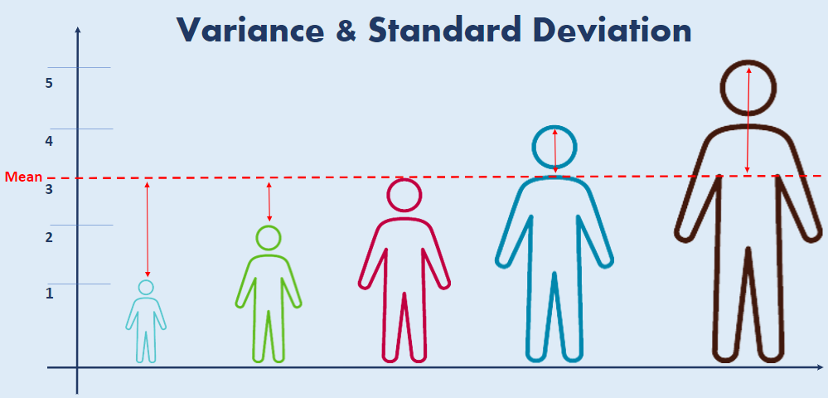

Slide 7
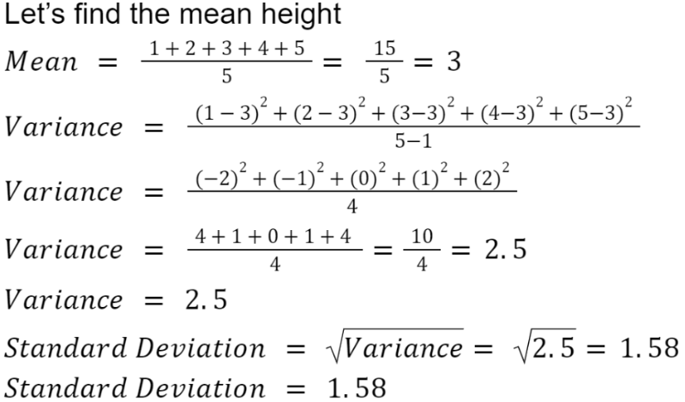

Slide 8
https://www.youtube.com/watch?v=1MiT06JFNo4&pp=ygUvbWVhc3VyZSBvZiBjZW50cmFsIHRlbmRlbmN5IGFuZCBkaXNwZXJzaW9uIGlpdCA%3D

